Slide 1

Presentation Title
Goes Here
Presenter Name
Presenter Title, Organization
© 2025 Northwest Energy Efficiency Alliance

Slide 2

Presentation Title
Goes Here
Presenter Name
Presenter Title, Organization
© 2025 Northwest Energy Efficiency Alliance

Slide 3
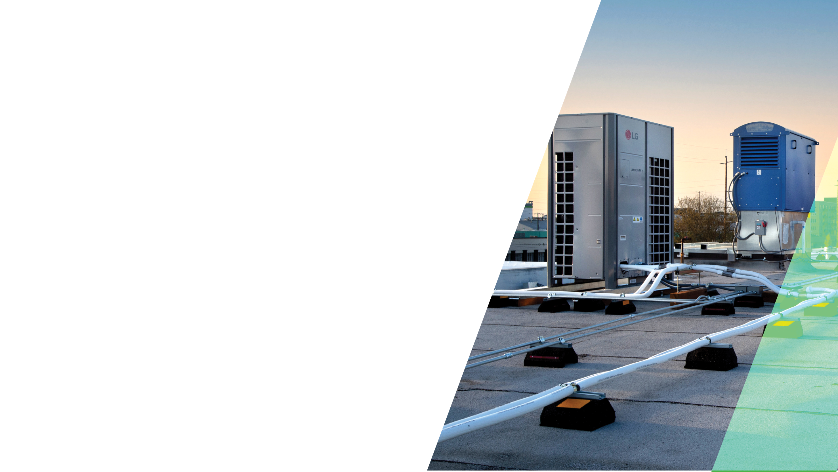
Presentation Title
Goes Here
Presenter Name
Presenter Title, Organization
© 2025 Northwest Energy Efficiency Alliance

Slide 4

Presentation Title
Goes Here
Presenter Name
Presenter Title, Organization
© 2025 Northwest Energy Efficiency Alliance

Slide 5
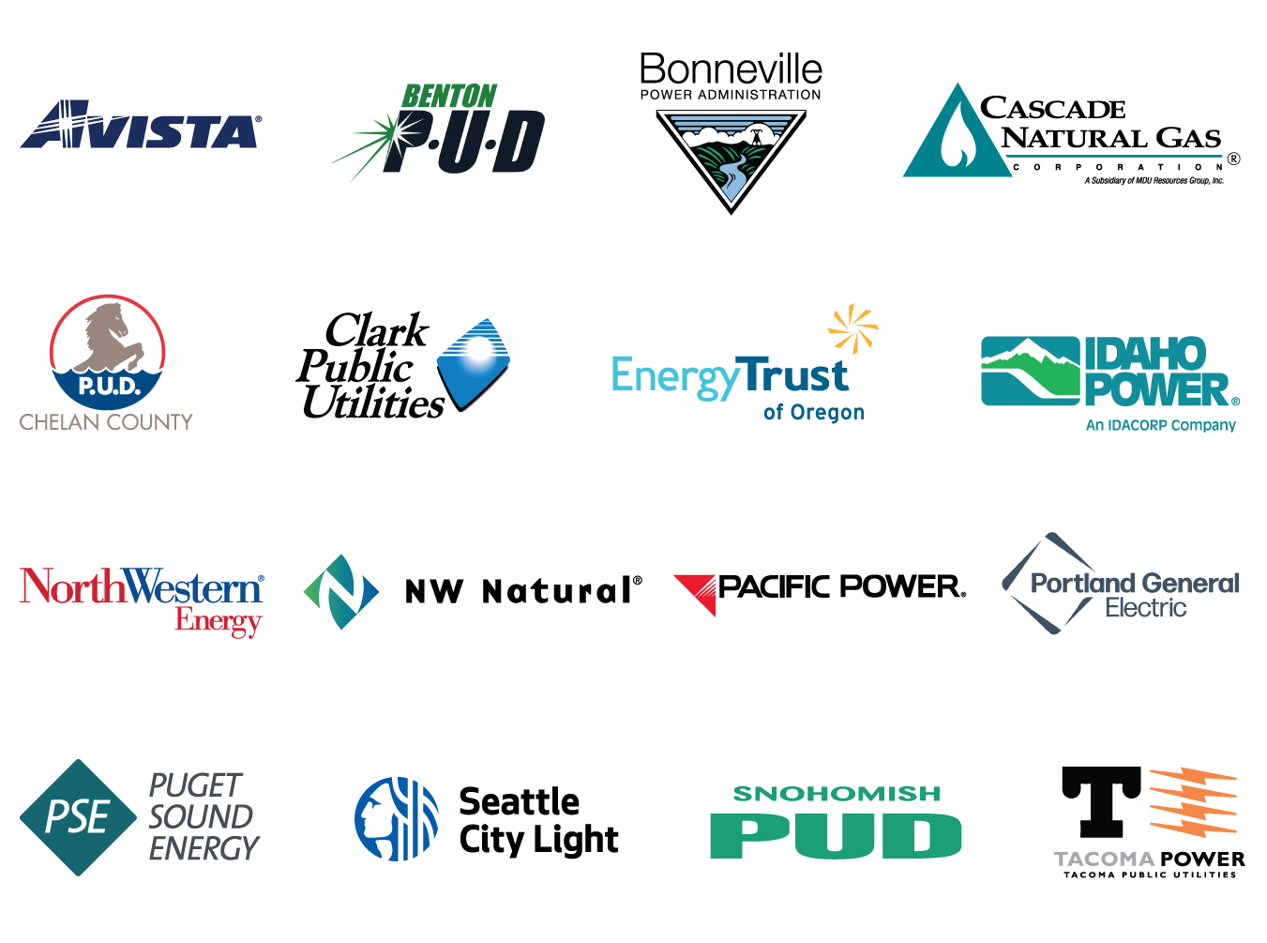

Who is NEEA?
Notes:
Northwest Energy Efficiency Alliance (NEEA) is an alliance of more than 140 utilities and energy efficiency organizations that works on behalf of more than 13 million energy consumers across the Northwest.
We [/they] are a nonprofit organization that works to accelerate the adoption of energy-efficient products, services, and practices—a process known as Market Transformation.

Slide 6





Who is BetterBricks?
+
=
Notes:
BetterBricks is a commercial resource delivered by NEEA to help Northwest building professionals gain a competitive edge in the market through the adoption of energy-efficient products and practices.

Slide 7
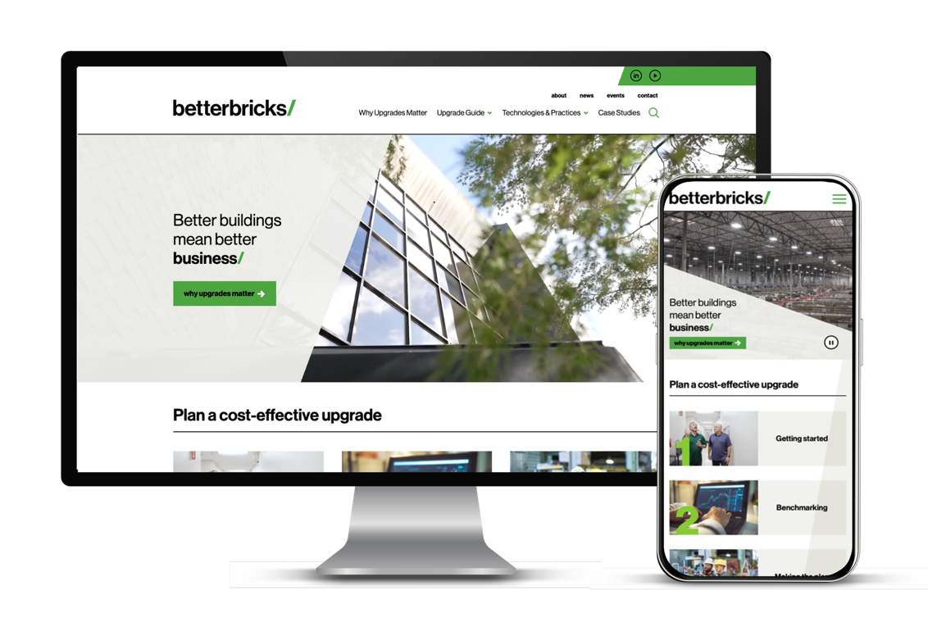
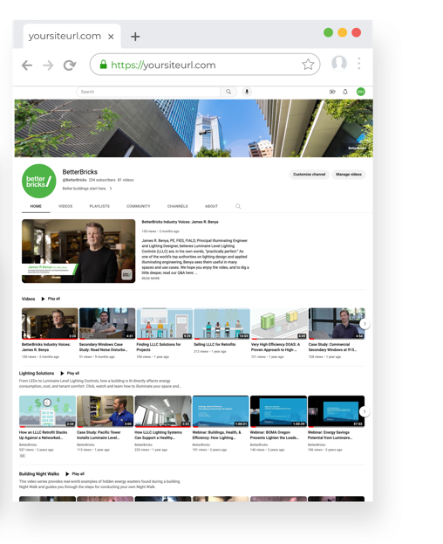
BetterBricks Tools and Resources​
Whether you design, build, manage or operate a commercial building, BetterBricks has the tools and resources to help you incorporate efficient products and practices that lead to more resilient,
healthy, and humane buildings.​
betterbricks.com​
LinkedIn/YouTube: @BetterBricks
Notes:
BetterBricks provides tools and resources to help commercial building designers, builders, managers, and operators incorporate proven products and practices that improve the efficiency, resiliency, health, and overall performance of commercial buildings.
You can explore a wide variety of content that we’re continually updating—including case studies, technical guides, live and on-demand webinars, white papers, and more—at Better-Bricks-dot-com, on LinkedIn, or YouTube, or sign up for our newsletter at Better-Bricks-dot-com-slash-newsletter.

Slide 12
© Northwest Energy Efficiency Alliance

Slide 13

Sed id lectus sollicitudin, eleifend nisl sed, mal ipsumdol. Sed id lectus sollicitudin, eleifend nisl sed, mal ipsumdol. Sed id lectus sollicitudin, eleifend nisl sed, mal ipsumdol. Sed id lectus sollicitudin, eleifend nisl sed, mal ipsumdol. Sed id lectus sollicitudin, eleifend nisl sed, mal ipsumdol.”
—Name Here
Title, Company

Slide 14
Energy Savings by Application
Title | Title | Title | Title | Title

Slide 15

Energy Savings by Application
XX%
Sed id lectus sollicitudin, eleifend nisl sed, mal ipsumdol.

Slide 16

Thank you!
Firstname Lastname
Title,Company Email address Website URL
Firstname Lastname
Title,Company Email address Website URL
© 2025 Northwest Energy Efficiency Alliance

Slide 17
Firstname Lastname
Title Company Email address Website URL
Firstname Lastname
Title Company Email address Website URL
Firstname Lastname
Title Company Email address Website URL

