Slide 1

Presentation Title
Goes Here
Presenter Name
Presenter Title, Organization
© 2024 Northwest Energy Efficiency Alliance

Slide 2



Who is NEEA?

Slide 3
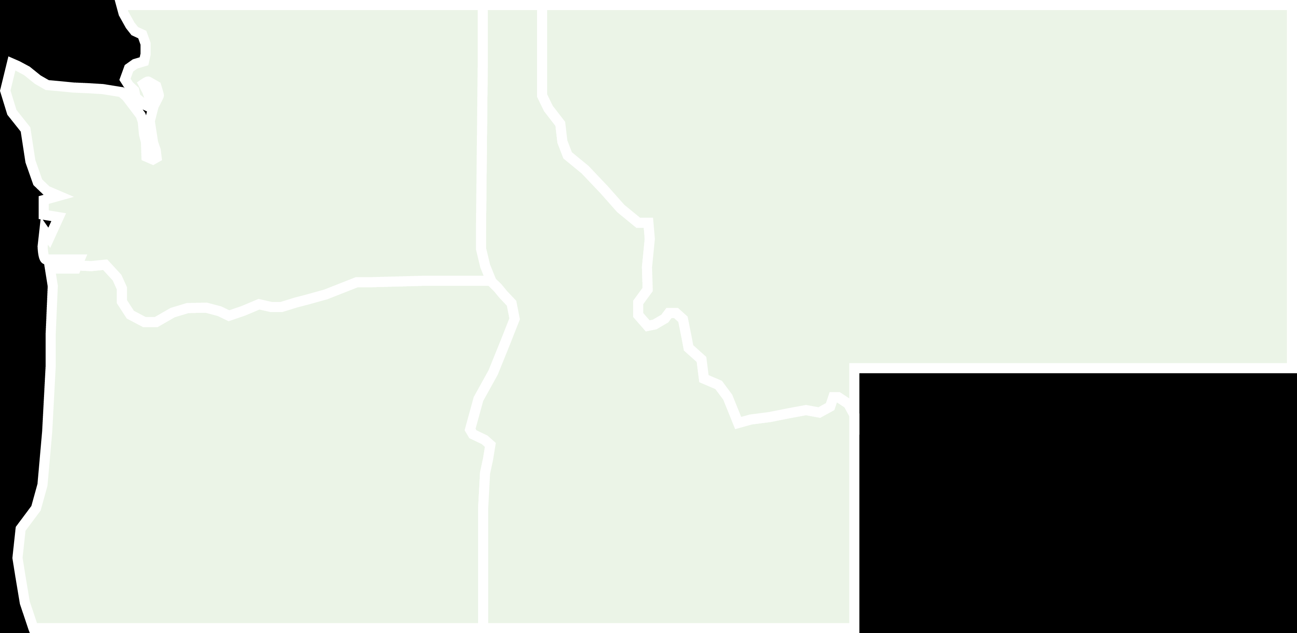




Who is BetterBricks?
+
=

Slide 4
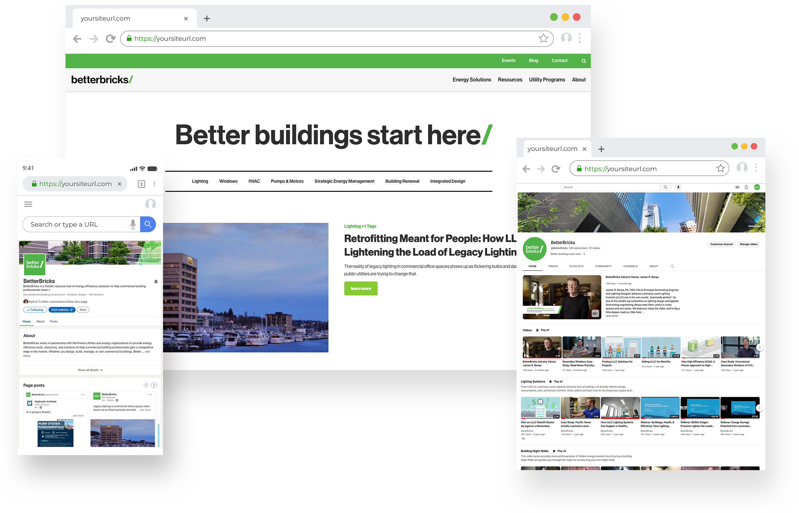
What is BetterBricks?
Working in partnership with Northwest utilities and energy organizations to provide energy efficiency tools, resources, and solutions to help commercial building professionals gain a competitive edge in the market. ​
betterbricks.com​
LinkedIn/YouTube: @BetterBricks

Slide 9
© Northwest Energy Efficiency Alliance

Slide 10

Sed id lectus sollicitudin, eleifend nisl sed, mal ipsumdol. Sed id lectus sollicitudin, eleifend nisl sed, mal ipsumdol. Sed id lectus sollicitudin, eleifend nisl sed, mal ipsumdol. Sed id lectus sollicitudin, eleifend nisl sed, mal ipsumdol. Sed id lectus sollicitudin, eleifend nisl sed, mal ipsumdol.”
—Name Here
Title, Company
© Northwest Energy Efficiency Alliance

Slide 11
Energy Savings by Application
Title | Title | Title | Title | Title

Slide 12
Energy Savings by Application
XX%
Sed id lectus sollicitudin, eleifend nisl sed, mal ipsumdol.

Slide 13

Thank you!
Firstname Lastname
Title,Company Email address Website URL
Firstname Lastname
Title,Company Email address Website URL

Slide 14
Firstname Lastname
Title Company Email address Website URL
Firstname Lastname
Title Company Email address Website URL
Firstname Lastname
Title Company Email address Website URL

